Slide 1
TUN Data Challenge
Hire Heroes USA
Group 3: Hope Spenik, Arthur Johne, Michael Calvelli, Ryan Castro, Jessica Lavrinovich

Slide 2
The Questions:
Is there a geographic location within the US that most of our individual donors come from?
Do our social media posts or fundraisers calling for donations hit these areas with little to no donors?

Slide 3
Motivation
Individual Donors Grassroots Fundraising
Core Benefits:
Establishes relationships
Sustained giving and participation
Grounded, broad support of HH’s mission

Slide 4
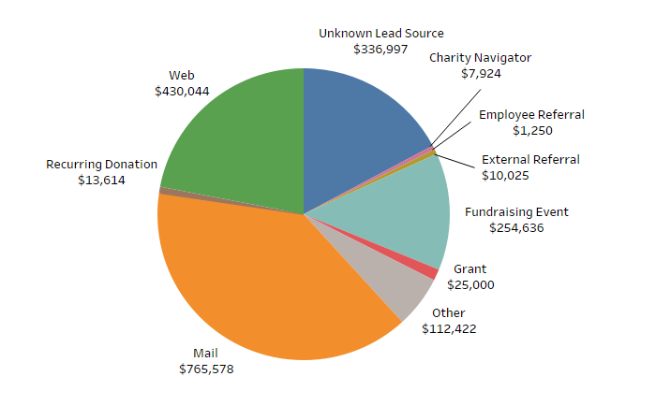
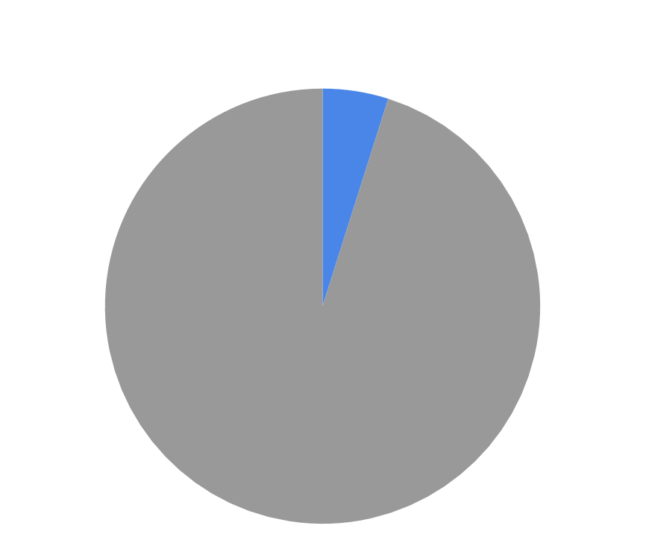
Top 10 Lead Sources - Individual Donors
Donors by By Donation Amount (2007-2019)
4.9%

Slide 5
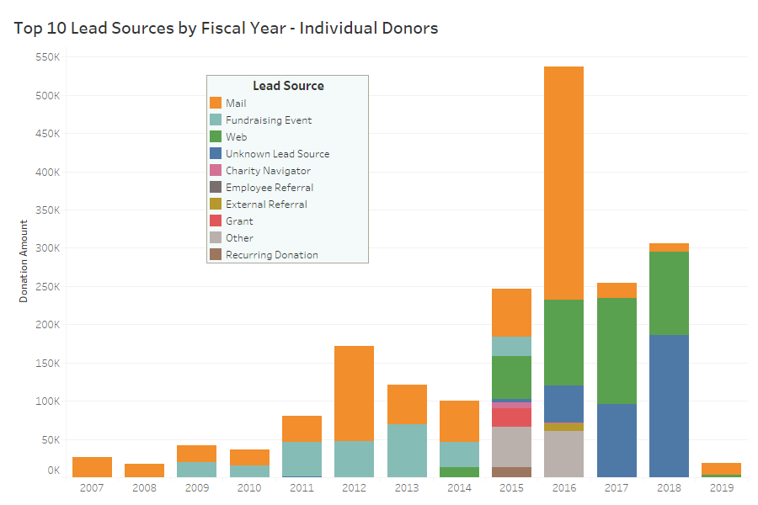
Top 10 Lead Sources by Fiscal Year - Individual Donors

Slide 6
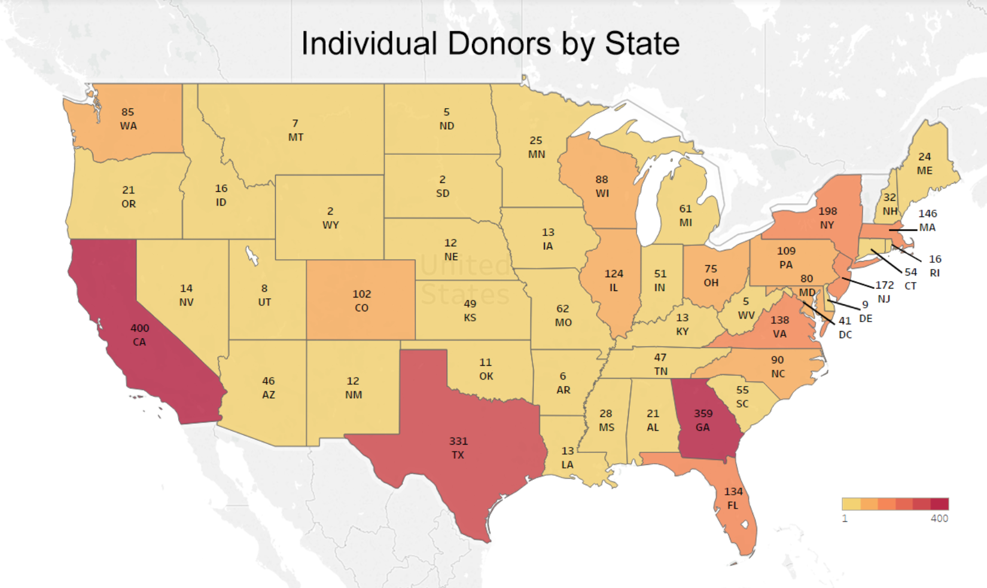

Slide 7
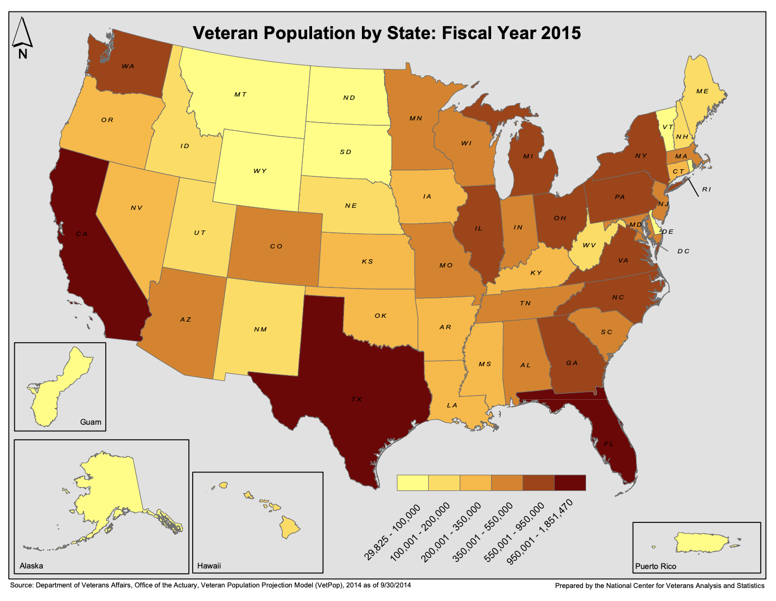
Veteran Population By State: 2015

Slide 8
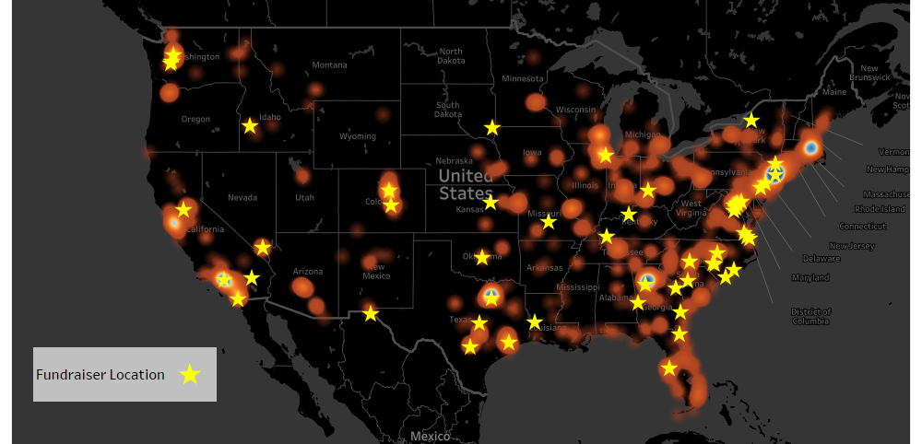
Individual Donor Heat Map with Fundraisers

